Slide 1


(Unit-II)
Noida Institute of Engineering and Technology, Greater No​ida
Indian Literature, Culture, Tradition, and Practices
UNIT: 2
Essence of Indian Traditional Knowledge
(AMICANC0502 )
Ms.Neha Singh
MCA Department
MCA VI semester

Slide 2
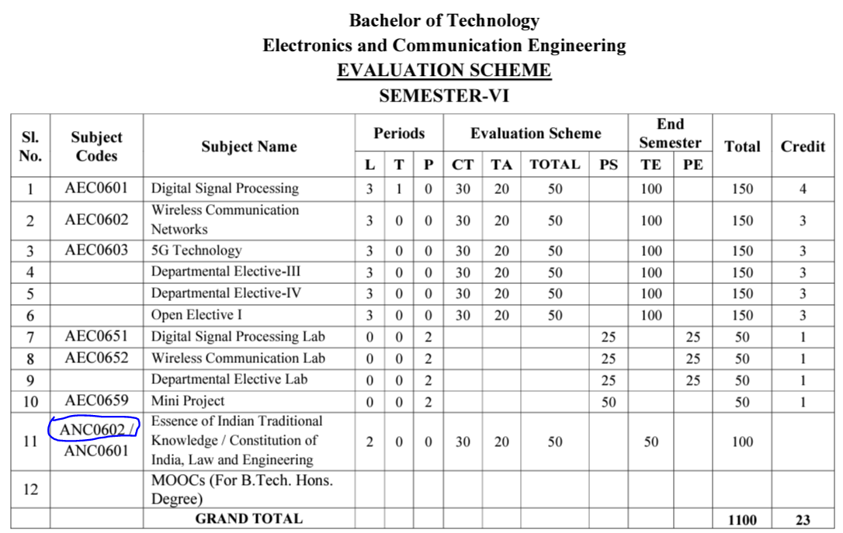
Evaluation Scheme (EC-6th Semester)

Slide 3
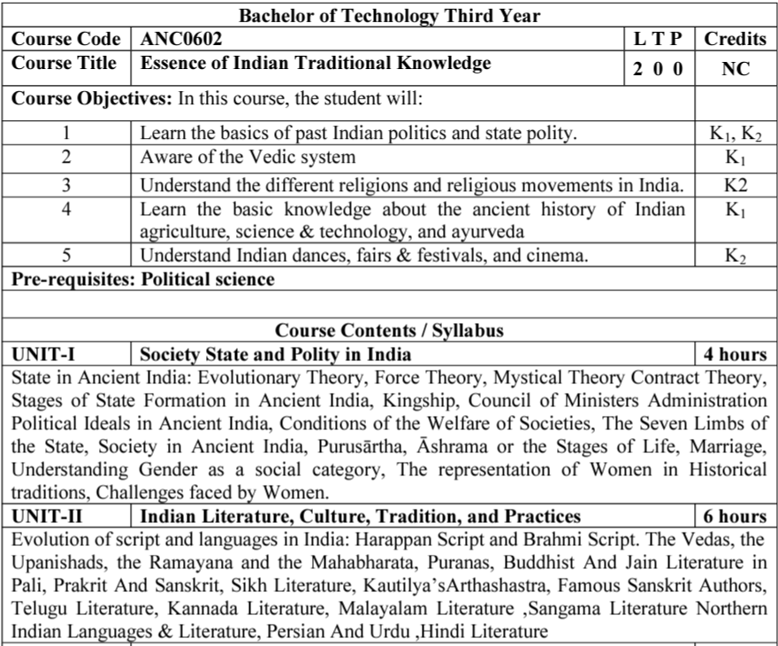
Syllabus

Slide 4
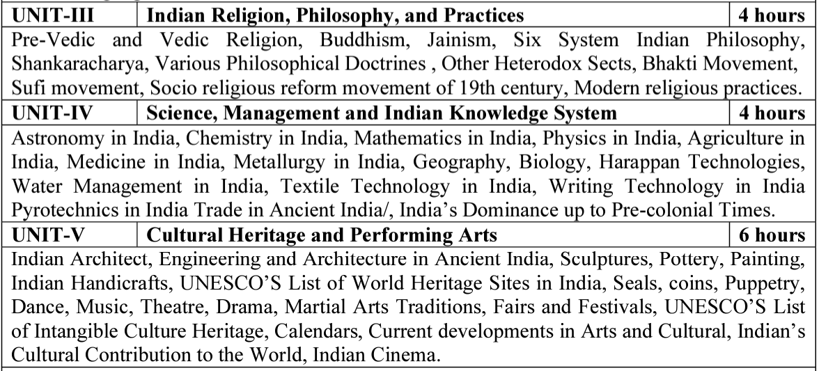
Syllabus(Continue….)

Slide 5
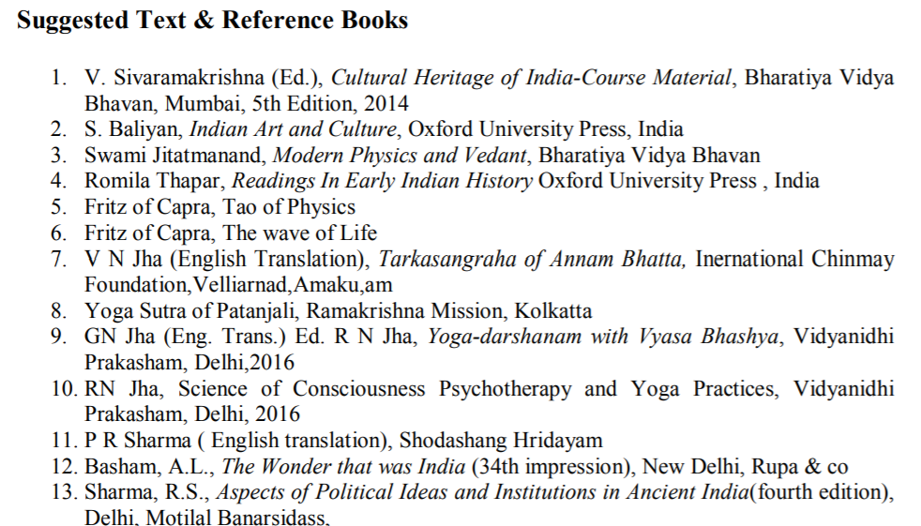
Text Books

Slide 6
Applications of Essence of Indian Traditional Knowledge
Can apply the old designing concept with blend of new trends in building construction
Learn the ancient living style
Indian Traditional knowledge modern scientific perspective
Apply the ancient advanced architectural wonders in current trends

Slide 7
Course Objective
Course Objectives:
The student will try to learn about:
To imparting the basic principles of thought process, reasoning and inference to identify the roots and details of some of the contemporary issues faced by our nation and try to locate possible solutions to these challenges by digging deep into our past.
To enable the students to understand the importance of our surroundings and encourage the students to contribute towards sustainable development.

Slide 8
Course Objective(Continue…)
To sensitize students towards issues related to ‘Indian’ culture, tradition and its composite character.
To make students aware of holistic life styles of Yogic-science and wisdom capsules in Sanskrit literature that are important in modern society with rapid technological advancements and societal disruptions.
To acquaint students with Indian Knowledge System, Indian perspective of modern scientific world-view and basic principles of Yoga and holistic health care system.

Slide 9
Course Outcome
At the end of this course students will able to:
CO1: Understand the basic principles of thought process & inference to identify the roots and details of some of the contemporary issues faced by our nation and try to locate possible solutions to these challenges by digging deep into our past.
CO2: Illustrate the importance of our surroundings and encourage the students to contribute towards sustainable development.
CO3: Interpret the issues related to ‘Indian’ culture, tradition, & its composite character.

Slide 10
Course Outcome (Continue…)
CO4: Aware of holistic life styles of Yogic-science and wisdom capsules in Sanskrit literature that are important in modern society with rapid technological advancements and societal disruptions.
CO5: Acquaint students with Indian Knowledge System, Indian perspective of modern scientific world-view and basic principles of Yoga and holistic health care system.

Slide 11
Program Outcomes
Program Outcomes are narrow statements that describe what the students are expected to know and would be able to do upon the graduation.
These relate to the skills, knowledge, and behavior that students acquire through the programmed.
Engineering knowledge
Problem analysis
Design/development of solutions
Conduct investigations of complex problems
Modern tool usage
The engineer and society
Environment and sustainability
Ethics
Individual and team work
Communication
Project management and finance
Life-long learning

Slide 12
Program Specific Outcomes
Program Specific Outcomes (PSOs) are what the students should be able to do at the time of graduation. The PSOs are program specific. PSOs are written by the department offering the program.
On successful completion of B. Tech. (EC) Program, the Electronics and Communication engineering graduates will be able to:
PSO1: To apply the knowledge of mathematics, science and electronics & communication engineering to work effectively in the industry based on same or related area.
PSO2: To use their skills to work in modern electronics & communication engineering tools, software and equipments to design solutions for complex problems in the related field that meet the specified needs of the society.
PSO3: To function effectively as an individual and as a member or leader of a team by qualifying through examinations like GATE (Graduate Aptitude Test in Engineering), IES (Indian Engineering Services), PSUs (Public Sector Undertakings), TOEFL (Test of English as a Foreign Language), GMAT (Graduate Management Admission Test) and GRE (Graduate Record Examinations in US) etc.

Slide 13
CO-PO and PSO Mapping
CO | PO1 | PO2 | PO3 | PO4 | PO5 | PO6 | PO7 | PO8 | PO9 | PO10 | PO11 | PO12 | PSO1 | PSO2 | PSO3
CO1 | - | - | - | - | - | - | - | 3 | - | - | - | 3 | - | - | -
CO2 | - | - | - | - | - | - | - | 3 | - | - | - | 3 | - | - | -
CO3 | - | - | - | - | - | - | - | 3 | - | - | - | 3 | - | - | -
CO4 | - | - | - | - | - | - | - | 3 | - | - | - | 3 | - | - | -
CO5 | - | - | - | - | - | - | - | 3 | - | - | - | 3 | - | - | -
Avg | - | - | - | - | - | - | - | 3 | - | - | - | 3 | - | - | -
*3= High *2= Medium *1=Low

Slide 14
Program Educational Objectives
The Program Educational Objectives (PEOs) of an engineering degree program are the statements that describe the expected achievements of graduates in their career, and what the graduates are expected to perform and achieve during the first few years after graduation.
PEO1: To have an excellent scientific and engineering breadth so as to comprehend, analyze, design and solve real-life problems using state-of-the-art technology.
PEO2: To lead a successful career in industries or to pursue higher studies or to understand entrepreneurial endeavours.
PEO3: To effectively bridge the gap between industry and academics through effective communication skill, professional attitude and a desire to learn.

Slide 15
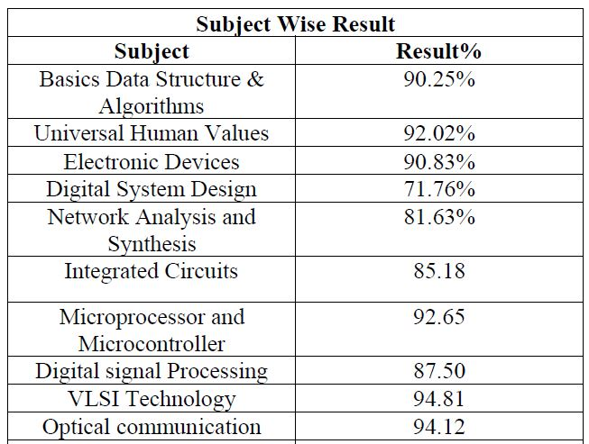
Result Analysis
Faculty Name | Subject Code | Section A | Section B
Mr. Anshu Kumar | ANC 0602 | 100 % | 100 %

Slide 16
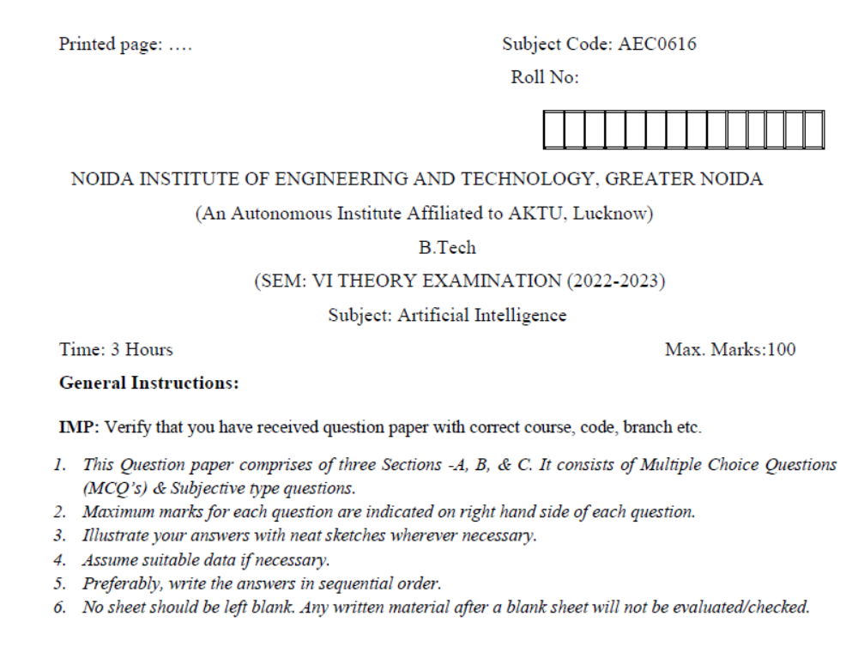
Question Paper Template

Slide 17
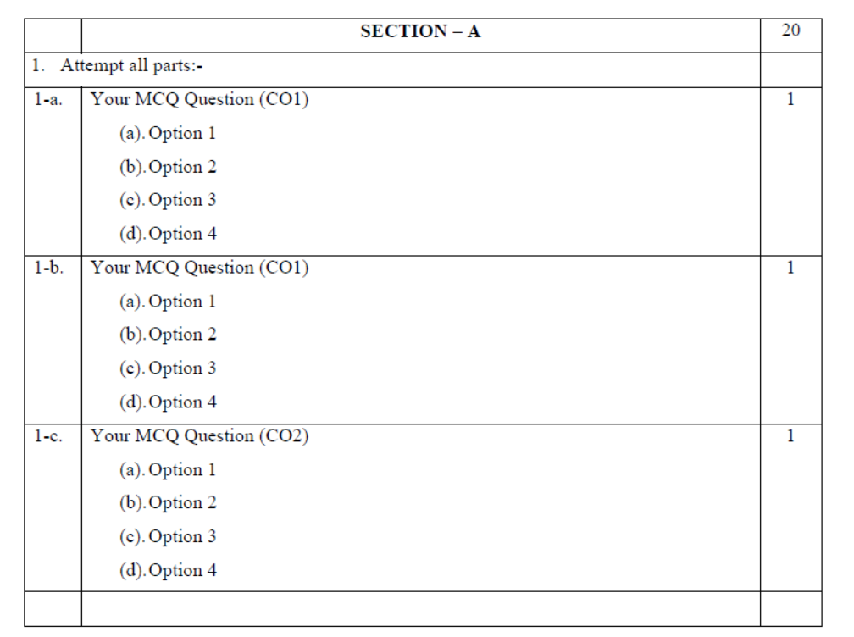
Question Paper Template (Cont……)

Slide 18
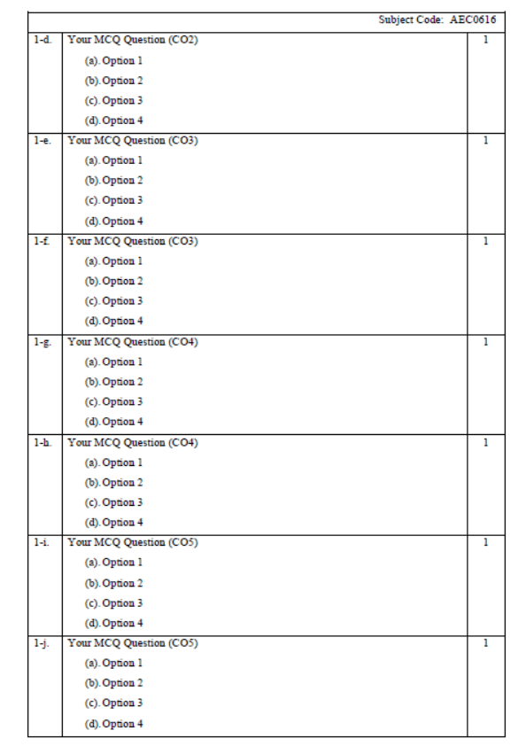
Question Paper Template (Cont……)

Slide 19
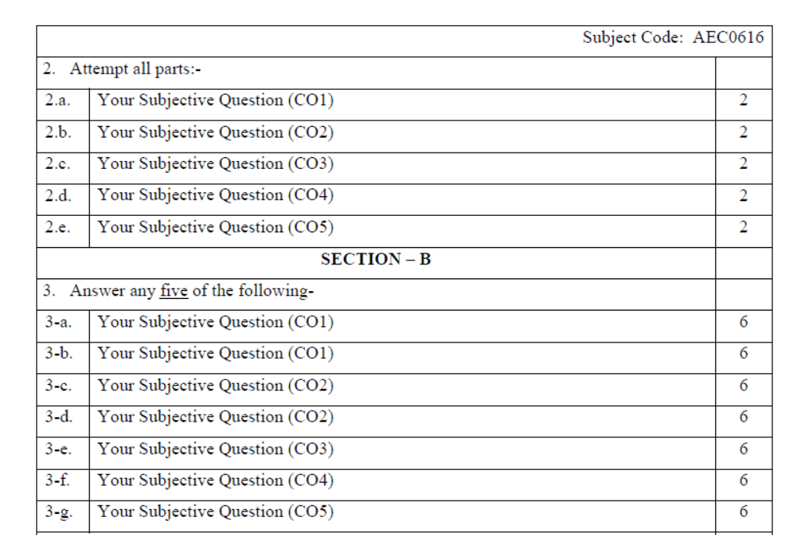
Question Paper Template (Cont……)

Slide 20
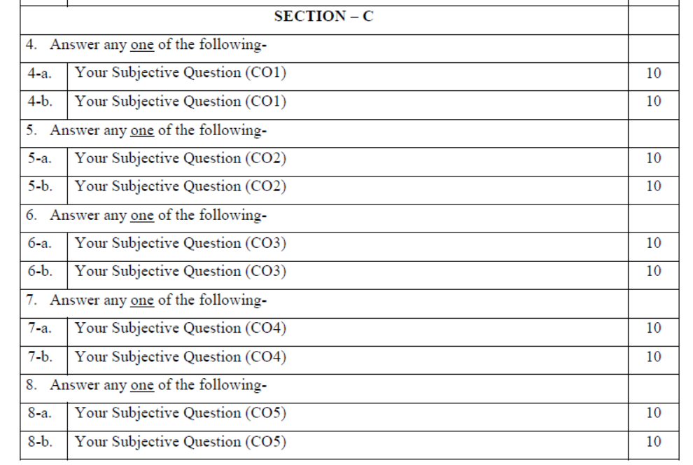
Question Paper Template (Cont……)

Slide 21
Prerequisite and Recap
Basic knowledge of Indian traditions, culture & society.

Slide 22
Brief Introduction about the subject with Video
The course aims at imparting basic principles of thought process, reasoning and inference & to identify the roots and details of some of the contemporary issues faced by our nation and try to locate possible solutions to these challenges by digging deep into our past. To enable the students to understand the importance of our surroundings and encourage the students to contribute towards sustainable development. To sensitize students towards issues related to ‘Indian’ culture, tradition and its composite character.
https://www.youtube.com/watch?v=jgQlf3DM_GU&t=625s

Slide 23
Module 2 Content
Evolution of script and languages in India
Harappan Script and Brahmi Script
The Vedas, The Upanishads,
The Ramayana & the Mahabharata and Puranas,
Buddhist And Jain Literature in Pali, Prakrit And Sanskrit,
Kautilya’s Arthashastra
Famous Sanskrit Authors,
Telugu Literature, Kannada Literature,
Malayalam Literature ,Sangama Literature
Northern Indian Languages & Literature,
Persian And Urdu Literature & Hindi Literature

Slide 24
Module 2 Objective
To enable the students to understand the importance of our surroundings and encourage the students to contribute towards sustainable development.

Slide 25
Topic Objective
Topic No. | Topic Objective
1 | To study the Evolution of script and languages in India
2 | To study the Harappan Script and Brahmi Script

Slide 26
Topic Mapping
S.No. | Topic | Course Outcome
1 | Evolution of script and languages in India | CO2 & CO3
2 | Harappan Script and Brahmi Script | CO2 & CO3

Slide 27
Evolution of script and languages in India (CO2)
Language is a set of specific sounds and symbols used as a means of communication by human beings.
Indian languages have evolved from different ethnic group belonging to the parts of eastern, western and central Asia who settled in the Indian sub-continent throughout history in different time periods.
Culture-linguistic amalgamation of Indian and Asian elements led to the development of dialects peculiar to certain regions of the country.
The exact causes of the origin of language are difficult to ascertain because no direct evidence has been found.

Slide 28
Evolution of script and languages in India
The writings of the human beings during the entire era of history have reflected the culture, lifestyle, society and the polity of contemporary society.
In this process, each culture evolved its own language and created a huge literary base.
This enormous base of literature provides us a glimpse of the evolution of each of its languages and culture through the span of centuries.

Slide 29
Evolution of script and languages in India
Language in its literary meaning is a system of communication through speech, a collection of sounds that a group of people understand to have the same meaning.
A language family includes individual languages related through a common ancestor that existed before the recorded history.
Dialect is a form of language spoken in a local area. It is noteworthy that several dialects can be derived from a particular language.
The languages spoken around the various corners of India belong to several language families, where most of them belong to the Indo-Aryan Group of Languages.

Slide 30
Evolution of script and languages in India
A script is also known as writing system or orthography.
It is a standard for representing the parts of a spoken language by making specific marks on a medium (Paper, rocks, birchbark, etc).
The two ancient scripts in India comprise Brahmi script and Kharosthi script.
Most of the ancient and modern scripts in India are developed from Brahmi script be it Devanagari, Tamil, Telugu, Kannada, Odia, Assamese/Bengali, etc.
Hence, it can very much be maintained that Brahmi is the mother of scripts.

Slide 31
Script (CO2)
Difference between Manuscripts & Inscriptions :
Manuscripts : It comes from the Latin word ‘Manu’ means Hand.
The hand written scripts written on Palm leaf is known as Manuscript.
It written on palm leaf or on the specially prepared bark of a tree known as the birch which grows in the Himalayas.
Inscriptions : words that are written or cut on something. These are writing on relatively hard surfaces such as stone, metal.
Archaeology : The study of ancient time.

Slide 32
Script
Historians, that is scholars who study the past, often use the word source to refer to the information found from Manuscripts, Inscriptions & Archeology.
What is Decipherment?
Decipherment is a process to understanding the changes of languages & Scripts over time.
All inscription contain both scripts & languages. Languages which were used as well as scripts, have changed over time.
So how do scholars understand and what was written? This can be done through a process known as Decipherment.

Slide 33

Harappan Script (CO2)
It is also known as Indus Script.
The Indus Script is a corpus of symbols produced by the Indus Valley Civilisation.
Most inscriptions are extremely short and it is unclear if these symbols constitute a script used to record a language.
The people of Harappan civilization used a pictographic language in which 396 different symbols were used.
This language was written in Boustrophedon style.
Fig:- Indus script

Slide 34
Brahmi Script (CO2)
Brahmi is the oldest writing systems used in the Indian subcontinent and in Central Asia during the final centuries BC and the early centuries AD.
Some believe that Brahmi was derived from contemporary Semitic Script (West Asia, North and East Africa, Malta) or Indus Script.
It is the oldest deciphered script of India.
All surviving Indic Scripts in South East Asia are descendants of Brahmi.
The best-known Brahmi inscriptions are the rock-cut edicts of Ashoka in North-Central India, dated 250–232 BC.

Slide 35
Brahmi Script
Rock-cut edicts of Ashoka script (Brahmi script) was deciphered in 1837 by James Prinsep.
This script developed into 2 major types in the regions of northern and southern India. In northern regions, the script is more angular and in southern regions, it is more circular.
Brahmi is usually written from left to right.
Brahmi is an abugida, meaning that each unit is based on consonant and the vowel notation is secondary, except when the vowels commence a word.

Slide 36
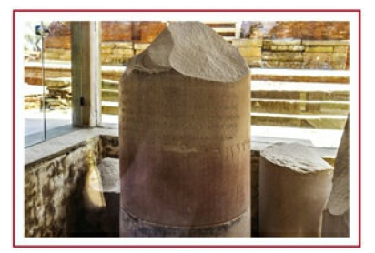
Brahmi Script
Fig:- Brahmi Script on Ashoka Pillar

Slide 37
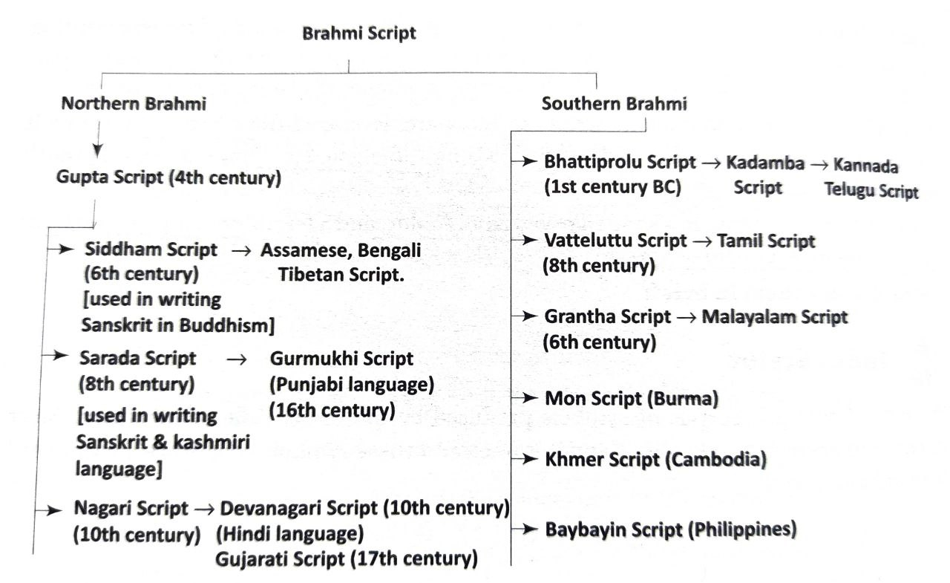
Brahmi Script
Fig:- Descendents of Brahmi Script

Slide 38
Recap
In this topic, We learned about the Evolution of script and languages in India, the Harappan Script and Brahmi Script.

Slide 39
Daily Quiz
How many symbols were used in Indus script?
A. 400
B. 426
C. 398
D. 396
Rock-cut edicts of Ashoka script was deciphered in 1837 by ________.
A. A. S. Altekar
B. James Prinsep
C. James Mill
D. V. A. Smith
Archaeology is the study of_______.
A. Modern Times
B. Contemporary time
C. Ancient Time
D. Medieval time

Slide 40
Daily Quiz
Which of the following is the most ancient language of India?
A. Pali
B. Prakrit
C. Ardha Magadhi
D. Sanskrit
Which Script is called the script of most Indian script?
A. Sarada
B. Gurumukhi
C. Brahmi
D. Devanagari
Which script is the oldest deciphered script of India?
A. Sarada Script
B. Kharosthi Script
C. Brahmi Script
D. Nagari Script

Slide 41
Daily Quiz
Indus script was written in Boustrophedon style.
A. True
B. False
Dialect is a form of language spoken in a local area.
B. True
C. False
Devanagari script was developed around 10th Century AD.
A. True
B. False
Inscriptions have written on palm leaves.
A. True
B. False

Slide 42
Weekly Assignment
Explain the evolution of script and language in India.
Why Brahmi script is called the mother of most Indian Script?
Why Sanskrit is called the mother of most Indian Language?

Slide 43
Prerequisite
Basic knowledge of Indian traditions, culture.
Knowledge of Vedic Text.
Basic knowledge of script.

Slide 44
Topic Objective
Topic No. | Topic Objective
1. | To understand the The Vedas and the Upanishads
2. | To study the Ramayana, the Mahabharata & Puranas

Slide 45
Topic Mapping
S.No. | Topic | Course Outcome
1 | The Vedas, the Upanishads, the Ramayana, the Mahabharata and Puranas, | CO2 & CO3

Slide 46
The Vedas (CO2)
The word ‘Veda’ signifies knowledge and the texts are actually about providing humans knowledge to conduct their entire life on earth and beyond. It is written in highly stylised poetic style and the language is full of symbols and myths.
The Vedas are the source of integral wisdom, science, tradition and culture of a remarkable civilization.
They are oral compilations of distilled wisdom of cosmic knowledge survived from the time immemorial.
They are not only identified as scriptures, but also as the fountain head of Indian culture and human civilization.

Slide 47
The Vedas
The Importance of the Veda :-
It has been universally acknowledged that the Veda is the earliest available literature of humanity.
The Veda contains the highest spiritual knowledge (Para vidya) as well as the knowledge of the world (Apara vidya). Thus, apart from philosophy, we find here descriptions of various aspects of the different subjects such as sciences, medicine, political science, psychology, agriculture, poetry, art, music etc.
The Veda is unique in its purity and sanctity.

Slide 48
The Vedas
The text of the Veda is preserved in its pure and original form without any alteration or interpolation even after thousands of years. The Veda is the only unadulterated treasure house of true knowledge. So much so that even UNESCO declared it as part of the Intangible cultural heritage of humanity.
The Vedic language is marked by extreme economy of expression. Many times it seems to carry some deep hidden meanings indicating mystical truths. Often it makes symbolic impression. The Vedic scholars have searched for and discovered the revelation of the deepest truth in the Vedic texts differently.

Slide 49
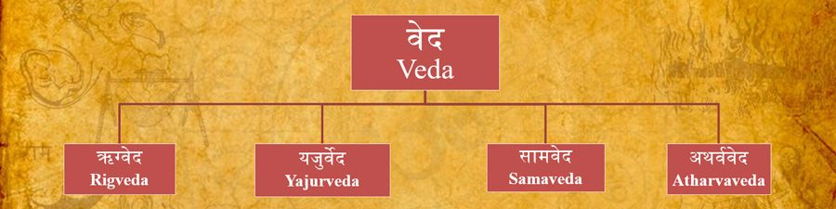
The Vedas
The Vedas have been transmitted from generation to generation through oral tradition. They are called the Srutis because they were recited and ‘heard’, not written and read.
The Veda in the form of prose and poetry in Sanskrit language, has been regarded as authoritative knowledge.
Fig:- Types of Veda

Slide 50
The Vedas
Each of these Vedas has 4 sub parts in the form of
(1) Samhitas (2) Brahmanas (3) Aranyakas (4) Upanishads
Samhitas: Samhitas are book of hymns. They contain Vedic hymns composed by sages in Sanskrit language. These are the original creations. These Hymns were orally transferred through generations. Every Veda has its Samhita.
Brahmanas: Brahmanas contain explanation of hymns. These explanation were crested by sages so that Vedic knowledge could be comprehended and used by mankind. These are elaborate prose texts.

Slide 51
The Vedas
Brahmanas are also known as Liturgies (ritual texts).
Brahmanas advocate Karma Marga for attainment of salvation.
Aranyakas: The term Aranyaka is derived from the word ‘Aranya’ meaning ‘forest’. The Aranyaka texts are so-called because ‘they were works to be read in the forest’ in contradistinction to the regular Brahmanas, which were to be read in the village.
The major contents of the Aranyakas are theosophy (Brahmavidya), meditation (Upasana) and knowledge of breath (Pranavidya).
They describe the secret meaning of the sacrifice and the concept of Brahma as well.

Slide 52
Rigveda
The Rig Veda is the oldest existing Veda amongst the other four. It consists of 1028 individual Sanskrit hymns.
It is said to be one of the first extensive composition in any Indo-European language that has survived for our perusal.
Historians argue that it was compiled around 1500-1200 BC.
The focus of this Veda is on worldly prosperity and natural beauty.
The text is organised in 10 books, known as Mandalas, of varying age and length.
Furthermore, each mandala comprises of several Suktas or hymns, which are usually for sacrificial purposes.

Slide 53
Rigveda
Most of the hymns concentrate on the themes of life, death, creation, sacrifice and for seeking godly pleasure or soma.
The entire Rig vedic hymns are dedicated to several deities, in particular to their Chief Deity, Lord Indra.
The other prominent Gods mentioned in the Rig Veda are Agni (God of fire), Varuna (God of water), Rudra (God of wind/storm), Aditya (A form of Sun God), Vayu (God of air) and the Ashwini twins.
Gayatri Mantra is part of the 3rd mandala of Rigveda. It was composed by Vishwamitra and it is dedicated to god savitr.

Slide 54
Yajurveda
The name ‘Yajus’ signifies ‘sacrifice’ and this Veda concentrates on rites and mantras of different types of sacrifices that were prevalent in the Vedic times.
There are two major recensions (samhita) of the Yajur Veda: Shukla (white/pure) and Krishna (black/dark).
These samhita’s are also called: Vajasaneyi Samhita and Taittiriya Samhita.
The Yajur Veda is predominantly a ritual Veda as it acts like a guide book for the rishis/priests who conduct sacrificial rituals.

Slide 55
Samaveda
Sama Veda has been named after ‘Saman’ (melody) and it concentrates on melody or songs. While the entire text has 1875 hymns, historians argue that 75 are original and the rest have been taken from the Sakala branch of the Rigveda.
It consists of hymns, detached verses and 16,000 raga (musical notes) and raginis.
It is because of the lyrical nature of the text that it has also been called the ‘book of chants’. It also shows us how Indian music had developed in the Vedic period.
Samveda is also known as the book of chanters.

Slide 56
Atharvaveda
The Atharva-Veda consisted of brahmans (magically potent mantras) so it is called the Brahma-Veda and has been attributed to two rishis called Atharvan and Angiras, respectively.
It is mostly concerned with peace and prosperity of the human society and covers all aspects of a man’s daily life, it specifically focuses on treatment of several ailments.
The Atharva-Veda presents perhaps the most complete account of primitive medicine.
The book is known to prescribe treatment for almost 99 diseases.

Slide 57
Atharvaveda
Gopatha Brahmana and Mundaka upnishad belong to Atharvaveda.
The phrase ‘satyameva Jayate’ is mentioned in Mundaka Upnishad.
Vedic age popular assemblies ‘Sabha’ and ‘Samiti’ are mentioned as twin daughters of Prajapati in Atharvaveda.
The Gopatha Brahmana is associated with the Atharvaveda and divided into two khandas (chapters), i.e. Purvabhaga and Uttarabhaga.
The Purvabhaga is divided into 5 prapathakas and 135 kandikas and the Uttarabhaga is divided into 6 prapathakas and 123 kandikas.

Slide 58
The Upanishads
If the Samhita is likened to a tree, the Brahmanas are its flowers and the Aranyakas are its fruit yet not ripened, the Upanishads are the ripe fruits.
Interestingly, the term Upanishad or u (at), pa (foot), ni (down) and s(h)ad (to sit), i.e. to sit down near (the teacher), describes the text completely.
The disciples used to sit down with their teacher who imparted them Vedic knowledge. Upanishads are 108 in number.
This tradition was part of the guru-shishya parampara.
Upanishads deal with philosophical and metaphysical issues.

Slide 59
The Upanishads
The earlier Upanishads such as ‘Brihadaranyaka Upanishad’ and ‘ ‘Chandogya Upanishad’ were written in prose. Later Upanishad such as ‘Kathopanishad’ & ‘Svetasvatara Upanishad’ were in verse form.
Upanishadic philosophy believes that individual soul is identical with supreme soul.
The Upanishads are said to have the ‘truth’ about human life and show the way towards human salvation or moksha.
They continue to talk about the abstract and philosophical problems faced by mankind.
The crux of Vedic knowledge is found in the Upanishads.

Slide 60
The Upanishads
The chief reason why the Upanishads are called the ‘end of the Veda’ is that they represent the central aim of the Veda and contain the highest and ultimate goal of the Veda as they deal with Moksha or Supreme Bliss.
According to the Muktikopanishad 108 Upanishads are divided according to four Vedas are as follows:
10 Upanishads from the Rigveda
51 Upanishads from the Yajurveda(19 from Shukla & 32 from Krishna)
16 Upanishads from the Samaveda and
31 Upanishads from the Atharvaveda.

Slide 61
The Upanishads
Importance of the Upanishads:
The Upanishads occupy a unique place in the development of Indian philosophical thought. Vedanta Philosophy is directly related to the Upanishads.
The Upanishads are associated with the Vedas and make the entire range of Vedic knowledge as complete.
They give importance to ‘Knowledge’ alone.
Without understanding the Upanishads, it is impossible to get an insight into Indian history and culture. Every subsequent development of philosophy and religion in India has drawn heavily on the Upanishads.

Slide 62
The Ramayana (CO2 & CO3)
The Ramayana and the Mahabharata represent both the ethos and the epos of ancient India.
The most famous and revered recension of the Ramayana is by the sage Valmiki who is also called as Adikavi or the first amongst the poets. By the same logic Ramayana is called Adikavya or the first amongst the poetry.
The epics had come into existence long before the art of writing was known. Down the centuries they were transmitted orally through, mainly, two classes of people: the sutas (bards in the royal courts); and the kusilavas (travelling singers).

Slide 63
The Ramayana
The Ramayana and the Mahabharata represent both the ethos and the epos of ancient India.
The most famous and revered recension of the Ramayana is by the sage Valmiki who is also called as Adikavi or the first amongst the poets. By the same logic Ramayana is called Adikavya or the first amongst the poetry.
Ramayana consists of 24,000 verses and is divided into seven books, called Khandas.
Rama triumphed over Ravana and This success has been considered to be the victory of good over evil.

Slide 64
The Mahabharata (CO2 & CO3)
The Mahabharata has several versions, but the most popular one is penned by Ved Vyas. It was written in Sanskrit and initially had 8,800 verses. This version was called ‘Jaya’ or the story of ‘victory’.
After that several stories were complied and added to this collection. The number of verses increased to 24,000 and it was renamed as ‘Bharata’ after the earliest Vedic tribes.
The current form consists of 1,00,000 verses and is divided into 10 parvas (chapters).
The story is based on the conflict between the Kauravas and the Pandavas over the right to claim the throne of Hastinapur.

Slide 65
The Puranas (CO2)
As the word ‘Purana’ suggests, these texts talk about ‘that which renews the old’.
These are ancient Indian mythological texts, which consist of the narrative stories about the creation of the universe and illustrate its history till the supposed destruction of the universe.
It contains the stories of the kings, heroes, sages, and demi-Gods, but it focuses on the divine trimurti or trinity/ three Gods: Brahma, Vishnu and Mahesh.

Slide 66
The Puranas
There are 18 major Puranas (Mahapuranas) and each gives prominence to a particular deity and expound on the philosophical and religious concepts related to them.
Some of the more prominent and well-known Puranas are Bhagvata, Brahma, Vayu, Agni, Garuda, Padma, Vishnu and Matsya.
These contain anecdotes about the social, cultural and religious life of post-Vedic India and provide the historians with critical information about the geography, history and the dynastic genealogies.
These Puranas are written in the form of stories.

Slide 67
Recap
In this topic, We learned about the Evolution of script and languages in India, the Harappan Script and Brahmi Script.
We also learned ,the Vedas and the Upanishads, the Ramayana, the Mahabharata & Puranas.

Slide 68
Daily Quiz
Which of the following is the most ancient Veda ?
A. Yajurveda
B. Samveda
C. Atharvaveda
D. Rigveda
Which one is not the part of veda ?
A. Upanishad
B. Samhita
C. Puranas
D. Brahmanas
Which Veda is known as origin of Music ?
A. Yajurveda
B. Samveda
C. Atharvaveda
D. Rigveda

Slide 69
Daily Quiz
Vedanta Philosophy is directly related to the _______.
A. Samhita
B. Brahmanas
C. Puranas
D. Upanishads
Which Veda is the source of treatment of almost 99 diseases?
A. Yajurveda
B. Samveda
C. Atharvaveda
D. Rigveda
Samhita is not the part of Vedas.
A. True
B. False

Slide 70
Daily Quiz
Rigveda contains _____Upanishad.
A. 10
B. 20
C. 15
D. 5
Samveda contains _____Upanishad.
A. 10
B. 18
C. 15
D. 16
Upanishad is the part of Vedas.
A. True
B. False

Slide 71
Weekly Assignment
Explain the contribution of Ramayana & Mahabharat in Indian Literature.
Explain the types of Vedas and writes its importance.

Slide 72
Prerequisite
Basic knowledge of Indian traditions, culture.
Basic knowledge of Buddhist and Jainism Literature.
Basic knowledge of Sanskrit language.

Slide 73
Topic Objective
Topic No. | Topic Objective
1 | To study the Buddhist And Jain Literature in Pali, Prakrit & Sanskrit
2 | To study the Kautilya’s Arthashastra & the Famous Sanskrit Authors
3 | To study the Telugu Literature, Kannada Literature,Malayalam Literature & Sangama Literature

Slide 74
Topic Mapping
S.No. | Topic | Course Outcome
1 | Buddhist And Jain Literature in Pali, Prakrit & Sanskrit | CO2
2 | Kautilya’s Arthashastra and Famous Sanskrit Authors | CO2
3 | Telugu Literature, Kannada Literature,Malayalam Literature & Sangama Literature | CO2

Slide 75
Buddhist & Jain Literature in Pali & Prakrit & Sanskrit (CO2 & CO3)
Pali & Prakrit languages gained prominence when religious literature of the Buddhists and Jains were composed.
The Buddhist literature can be divided into Canonical and Non-canonical works. The Canonical literature consists of ‘Tripitaka’ or baskets (of knowledge) written in Pali.
The great epic Buddhacharita by Asvaghosha is another example of Buddhist Literature in Sanskrit.
Jainism, produced texts in Prakrit. They form the basis of the Jain canonical literature.

Slide 76
Buddhist & Jain Literature in Pali & Prakrit & Sanskrit
Some of the Jain texts were also written in Sanskrit like the Upamitibhava Prapancha Katha of Siddharasi (906 AD). The most important Jain texts written in Prakrit are the Agamas.
Shantinatha Charitra is another important jain text on 16th tirthankara Shantinatha and written in Sanskrit. UNESCO declared it a global treasure.
Prakrit poetry has some elements of erotica through texts like the Gatha Saptasati (700 verses) by Hala.

Slide 77
Sikh Literature
Sikhism is relatively a new religion established in 15th century, and is based on the teachings of Guru Nanak.
The beliefs and philosophies of Sikhism are written in the sacred scripture, Guru Granth Sahib.
Gurbani is the composition and hymns of Sikh Gurus and the Guru Granth Sahib.

Slide 78
Sikh Literature
The important literary works related to Sikhism are:
Adi Granth: It was compiled by Bhai Gurdas under the aegis of the fifth guru, Guru Arjan Dev in 1604. It is a predecessor to Guru Granth Sahib. The book contains the teachings of the Sikh Gurus and 15 Bhagats of Bhakti and Sufi traditions.
Guru Granth Sahib: Adi Granth was further expanded in 1678 under the 10th guru Guru Gobind Singh. It is of great regard to the Sikhs. It is regarded as the 11th and final spiritual authority of the Sikhs. It is written in Gurmukhi script and is in a language called ‘Sant Bhasha’. Sant Bhasha contains words from various languages like Punjabi, Apabhramsa, Hindi, Braj Bhasha, Sanskrit, Khadiboli and Persian.

Slide 79
Sikh Literature
The book also contains the teachings of Bhakti saints, called ‘Bhagats’ like Ramananda, Namdev, Ravidas, Parmanand, Sain, Surdas, etc. and two Muslim Bhagats- Kabir and Baba Farid.
Dasam Granth: It is believed that the hymns written by Guru Gobind Singh are compiled in this book, however many do not agree with this. These contain fables and puranic stories. Some hymns of the book are supposed to be offered in the daily prayers called “Nitnem”.
Janamsakhis: These books contain the stories of the first guru, Guru Nanak. The most popular book is “Bhai Bala Janamsakhi”. Others are Miharban Janam Sakhi and Adi Janam Sakhi.

Slide 80
Kautilya’s Arthashastra (CO2)
Arthashastra was written by chankya/kautilya. He was the Prime minister of Chandragupta Maurya.
It was written in Grantha script.
Arthashastra deals with politico-administrative and economic issues.
This is a book of statecraft. It teaches how to establish an empire and preserve it.
It is divided into 15 Adhikarnas (parts). It contains 150 Prakarnas (chapters).
It has been translated into German, French and many other languages.

Slide 81
Famous Sanskrit Authors (CO2)
Kalidasa (His three major plays)
Malavikagnimitra (The love story of Malavika a maiden of Queen and Agnimitra the son of Pushyamitra Shunga)
Vikramorvasiya (Love story of Vikram and Urvasi) Abhigyana Shakuntalam (The Recognition of Shakuntala)
Sudraka
Mricchakatika (The Little Clay Cart) Love affair of young brahmin Charudatta with a wealthy courtesan.

Slide 82
Famous Sanskrit Authors
Vishakhadutta
Mudrarakshasa (Is a political drama and narrates ascent of king Chandragupta Maurya to power in India).
Devi Chandraguptam
Bhavabhuti
Uttara Ramacharitam (The later life of Rama). It was written in 700 AD.

Slide 83
Famous Sanskrit Authors
Bhasa
Swapnavasavadatta (Vasavadatta in dream), Pancharatra, Urubhanga (Story of Duryodhana during and after his fight with Bhima.
Harshavardhana
Ratnavali (About the love story of princess Ratnavali, daughter of the King of Ceylon and King Udayana. The mention of celebration of Holi for the first time can be found here).
Nagananda (Story of how Prince Jimutavahana gives up his own body to stop a sacrifice of serpents to the divine Garuda.
Priyadarsika (Union of Udayana and Priyadarsika)

Slide 84
Telugu Literature (CO2)
Telugu literature is the body of works written in the Telugu language.
Telugu literature, body of writings in Telugu, a Dravidian language majorly spoken in Andhra Pradesh and Telangana state of India.
The literature, beginning in the 10th or 11th century, is mainly poetry and secular and religious epics, with the śataka (“century” of verses) as a very popular form.
Literature in the Telegu language made great progress from 13th century onwards.
During the 13th and 14th centuries ,Telugu translations and adaptations of Sanskrit works were produced.

Slide 85
Telugu Literature
The most important Telegu poet in the first half of the 14th century was Errapragada. He composed Ramayana in champu genre (a mixed form of verse and prose). He translated a part of the Mahabharata and another Vaishnava Sanskrit Work, Harivamsa into Telugu.
Srinatha was another great Telugu writer translated Sriharsha’s Naishadha Kavya into Telugu.
The Telugu literature achieved its highest position in the 16th century during the reign of Vijanagar empire Krishanand rai ,who himself was a poet in both Sanskrit and Telegu and wrote Amukta Malyadain Telugu. Telugu was the court language along with Sanskrit.

Slide 86
Kannada Literature (CO2)
The Jain scholars made the first foray into the Kannada literature.
The best example of a Jain-influenced text is Dharmanathapurana written by Madhava on the life of the 15th Tirthankara.
Several other scholars like Uritta Vilasa wrote Dharma Parikshe on the Jain teachings of this period.
One of the first recorded texts in Kannada is called Kavirajamarga, which was written by Amoghavarsha I, in the 9th century.
He was also a very powerful Rashtrakuta king.

Slide 87
Kannada Literature (CO2)
Kannada language has many great poets but the ‘the three gems’ were unparalleled. They were—
Pampa (9th-10th century AD),
Ponna (9th-10th century AD) and
Ranna (10th-11th century AD).
It was also in the 10th century that Pampa, better known as the ‘Father of Kannada’ wrote two of his greatest poetic works, Adipurana (written in Champu style) and Vikramarjuna Vijaya.

Slide 88
Kannada Literature
Pampa who was renowned for his mastery over the rasa involved in the poetic compositions, was attached to the court of Chalukya Arikesari.
The second gem or Ponna has written a famous treatise, titled Shanti Purana and the third gem, Ranna has authored Ajitha Purana.
These two poets were attached to the court of the Rashtrakuta King Krishna III.
Although Kannada became a full-fledged language by the 10th century, but the growth of Kannada literature has been closely attributed to the patronage from Vijayanagara empire.

Slide 89
Malayalam Literature (CO2)
Malayalam is usually spoken in Kerala and surrounding areas. Two of the major Malayalam works of the medieval period are Kokasandisan and Bhasa Kautilya (a commentary on Arthashastra).
Another major literary work in Malayalam is Ramacharitam, an epic poem written by Cheeraman in 12th century.
Ezhuthachan, a strong proponent of Bhakti movement, is known as the Father of Malayalam Language.
Champu:- It is a literacy style and refers to the combination of poetry and prose. This style or genre has been used in Telugu, Odia, Kannada as well as Sanskrit literature.

Slide 90
Sangama Literature (CO2)
Tamil literature is known as Sangama Literature.
‘Sangam’ means fraternity and this literature was very popular amongst the masses.
This literature is a collection of works that contains approximately 2381 poems that have been attributed to 473 poets and there is a corpus of literature written by 102 poets that remains anonymous.
The poets included men and women from different classes of society.
The literary tradition was so popular that the period between 300 BC and 300 AD, during which most of these were composed and compiled, is often called Sangam period.

Slide 91
Sangama Literature
There are two major schools of Sangam literature:
Aham/Agam which is the ‘inner field’ and concentrates on the abstract discussion of human aspects like love, sexual relations, etc.
The second school is the ‘puram’ or the ‘outer field’ which discusses the human experiences like social life, ethics, valour, customs, etc.
This literature bears the name ‘Sangam’ because the kingdom of Pandya organized assemblies where poets, bards and writers joined from various parts of South India and these assemblies were called ‘Sangamas’. Literature produced in the duration of these assemblies was called Sangam literature.

Slide 92
Sangama Literature
The Sangam literature, around 30,000 lines of poetry, has been arranged in eight anthologies called Ettuthogai.
The very famous and revered Tamil Saint Thiruvalluvar had contributed the ‘Tirukkural’ to the Sangam literature.
It has been now translated in several languages and is divided into three parts which discuss the epics, polity governance and love. Another famous female Saint who contributed to Sangam literature is Avvaiyar.

Slide 93
Sangama Literature
Apart from the Sangam literature, there are many well-known texts written in Tamil.
The Tolkappiyam was written to elaborate on the nuances of Tamil grammar and poetry. Like the twin Sanskrit epics, Ramayana and Mahabharata, even Tamil has two major texts written in 6th century AD, i.e. Silappadikaram (tale of an anklet) which was written by Ilango-Adigal.
The second text is Manimekalai (the story of Manimekalai) written by Satthanar. These texts focus on the Tamil society and the economic and political changes it was experiencing.

Slide 94
Recap
In this topic, We learned about Kautilya’s Arthashastra, the Famous Sanskrit Authors.
We also learned,the Telugu Literature, Kannada Literature & Malayalam Literature and Sangama Literature.

Slide 95
Daily Quiz
Which of the following is the oldest Dravidian language ?
A. Kannada
B. Telegu
C. Malayalam
D. Tamil
Buddha Charita was written by ?
A. Panini
B. Kautilya
C. Asvaghosha
D. Kamndaka
Thiruvalluvar is the famous saint of which language?
A. Kannada
B. Telegu
C. Malayalam
D. Tamil

Slide 96
Daily Quiz
Which literature is known as Sangama literature ?
A. Kannada
B. Telegu
C. Malayalam
D. Tamil
_____ is known as Father of Malayalam Language.
A. Panini
B. Ezhuthachan
C. Asvaghosha
D. Kamndaka
______has authored Ajitha Purana?
A. Ranna
B. Ezhuthachan
C. Asvaghosha
D. Kamndaka

Slide 97
Daily Quiz
Upamitibhava Prapancha Katha was written by______ .
A. Ezhuthachan
B. Hala
C. Siddharasi
D. Asvaghosha
Upamitibhava Prapancha Katha was written in ______language.
A. Pali
B. Prakrit
C. Sanskrit
D. Tamil
Uttara Ramacharitam was written by _____?
A. Vishakhadutta
B. Bhavabhuti
C. Sudraka
D. Kalidas

Slide 98
Weekly Assignment
Why Tamil literature called Sangama literature?
What is Champu?
Explain the Evolution of Buddhist and Jainism literature in Pali, Prakrit & Sanskrit languages.
Father of Malayalam Language

Slide 99
Prerequisite
Basic of Indian tradition, culture & Society

Slide 100
Topic Objective
Topic No. | Topic Objective
1 | To study the Northern Indian Languages & Literature, Persian, Urdu and Hindi Literature

Slide 101
Topic Mapping
S.No. | Topic | Course Outcome
6 | Northern Indian Languages & Literature | CO2 & CO3
7 | Persian, Urdu and Hindi Literature | CO2 & CO3

Slide 102
Northern Indian Languages &
Literature (CO2)
The studies have indicated that all the scripts of present northern Indian languages, except that of Urdu, have had their origin in old Brahmi.
A long and slow process had given them this shape. If we compare the scripts of Gujarati, Hindi and Punjabi, we can easily understand this change.
As for the spoken word, there are over 200 languages or dialects spoken in India at present.
Some are widely used while others are limited to a particular area.

Slide 103
Northern Indian Languages &
Literature
A large number of people speak Hindi in its different forms that include Braj Bhasha, and Avadhi (spoken in Oudh region), Bhojpuri, Magadhi, and Maithili (spoken around Mithila), and Rajasthani and Khadi Boli (spoken around Delhi).
Rajasthani is another variant or dialect of Hindi. This classification has been made on the basis of literature produced by great poets over a length of time.
Thus, the language used by Surdas and Bihari has been given the name of Braj Bhasha; that used by Tulsidas in the Ramacharitamanasa is called Avadhi and the one used by Vidyapati has been termed as Maithili.

Slide 104
Urdu (CO2)
Urdu emerged as an independent language towards the end of the 4th century AD.
Arabic and Persian were introduced in India with the coming of the Turks and the Mongols.
Persian remained the court language for many centuries.
Urdu as a language was born out of the interaction between Hindi and Persian.
After the conquest of Delhi (1192), the Turkish people settled in this region.

Slide 105
Urdu
Urdu was born out of the interaction of these settlers and soldiers in the barracks with the common people.
Originally it was a dialect but slowly it acquired all the features of a formal language when the authors started using Persian script.
It was further given an impetus by its use in Bahamani states of Ahmadnagar, Golkunda, Bijapur and Berar. Here it was even called dakshini or daccani (southern). As time passed, it became popular with the masses of Delhi.
Urdu became more popular in the early eighteenth century. People even wrote accounts of later Mughals in Urdu

Slide 106
Urdu
Urdu was given its pride of place by a large number of poets who have left inimitable poetry for posterity.
The earliest Urdu poet is supposed to be Khusrau (1253-1325).
He started writing as a poet in the reign of Sultan Balban and was a follower of Nizam ud-din Auliya.
He is said to have composed ninty-nine works on separate themes and numerous verses of poetry. Among the important works composed by him are Laila Majnun and Ayina-I-Sikandari dedicated to Alau-din-Khalji.

Slide 107
Urdu
Among other well-known poets are Ghalib, Zauq, and Iqbal. Iqbal’s Urdu poetry is available in his collection called Bang- i - dara.
His Sarejahan se achcha Hindostan hamara is sung and played at many of the national celebrations in India. No army parade is considered complete without the army band playing this tune.
Even in the early days, Munshi Prem Chand, who is supposed to be a doyen of Hindi literature, wrote in Urdu. Urdu has given us a new form of poem that is called a nazm. Urdu was patronized by the Nawabs of Lucknow, who held symposiums in this language. Slowly it became quite popular. Pakistan has adopted Urdu as the state language.

Slide 108
Persian
Baber was himself a great scholar of Persian.
As Persian was the language of the court, much of the literature produced in this period was written in Persian. Amir Khusrau and Amir Hasan Dehelvi wrote superb poetry in Persian.
Historians like Minhas-us-Siraj and Zia Barani and Ibn Batuta who came to India during those days wrote accounts of rulers, important political events and incidents in this language.
In the medieval period, Persian was adopted as the court language. Several historical accounts, administrative manuals and allied literature in this language have come down to us.

Slide 109
Persian & Urdu
The mughal rulers were great patrons of leaning and literature. Babar wrote his tuzuk (autobiography) in Turkish language, but his grandson Akbar got it translated into Persian.
Akbar patronized many scholars. He got Mahabharata translated into Persian. Jahangir’s autobiography (Tuzuk-i-Jahangiri) is in Persian and is a unique piece of literature.
It is said that Noorjahan was an accomplished Persian poetess. Quite a fair amount of Persian literature has been produced by the courtiers of the Mughals. Abul Fazl’s Akbarnamah and Ain-e-Akbari is a fine piece of literature.

Slide 110
Hindi Literature (CO2)
Prithviraj Raso is supposed to be the first book in the Hindi language.
Hindi literature looked to Sanskrit classics for guidance and Bharata’s Natyashastra was kept in mind by Hindi writers.
During the twelfth and thirteenth centuries there started a movement in southern India that was called the Bhakti movement.
As its influence reached the north, it started affecting the prose and poetry that were being composed in Hindi.
Poetry now became largely devotional in nature.

Slide 111
Hindi Literature
Hindi evolved during the Apabhramsa stage between the 7th and 8th centuries A.D.
It was characterized as Veergatha Kala i.e. the age of heroic poetry or the Adi Kala (early period).
It was patronised by the Rajput rulers as it glorified chiralry and poetry. The most famous figures from this period were Kabir and Tulsidas.
Bharatendu Harishchandra was one of the earliest to produce dramas in Hindi which were basically translations of texts written in Sanskrit and other languages.

Slide 112
Hindi Literature
Among other names who have enriched Hindi literature, is that of Munshi Prem Chand, who switched over from Urdu to Hindi.
Surya Kant Tripathi, ‘Nirala’, achieves recognition because he questioned the orthodoxies in society.
Mahadevi Verma is the first woman writer in Hindi to highlight issues related to women. Maithili Sharan Gupt is another important name. Jaishankar Prasad wrote beautiful dramas.

Slide 113
Hindi Literature
Bhartendu Harish Chandra, Mahavira Prasad Dwivedi, Ramchandra Shukla and Shyam Sunder Das were the main among the prose writers of Hindi literature.
Jai Shanker Prasad, Maithalisharan Gupta, Sumitranandan Pant, Suryakant Tripathi ‘Nirala’, Mahadevi Verma, Ramdhari Singh ‘Dinkar’ and Haribans Rai ‘Bacchan’ made great contribution to the development of Hindi poetry.
Similarly Prem Chand, Vrindavan lal Verma and Ellachandra Joshi wrote novels and enriched Hindi literature.

Slide 114
Recap
In this topic, We learned about Northern Indian Languages & Literature.
We also learned, the Persian And Urdu and Hindi Literature.

Slide 115
Daily Quiz
Which of the following has written novels in Hindi literature?
A. Prem Chand
B. Jai Shanker Prasad
C. Maithalisharan Gupta
D. Sumitranandan Pant
Babar wrote his autobiography in which language ?
A. Sanskrit
B. Parsi
C. Tuzk
D. Urdu
Prithviraj Raso is the first book in the Hindi language.
A. True
B. False

Slide 116
Daily Quiz
Tuzuk-i-Jahangiri was written in _____.
A. Sanskrit
B. Persian
C. Tuzk
D. Urdu
Urdu emerged as an independent language towards the end of the ______century AD.
A. 5th
B. 4th
C. 6th
D. 7th
Urdu became more popular in the early eighteenth century.
A. True
B. False

Slide 117
Daily Quiz
Which one of the following is the first woman writer in Hindi to highlight issues related to women.
A. Amrita Pritam
B. Anita Desai
C. Mahadevi Verma
D. Anuja Chauhan
Rajasthani is another variant or dialect of_____.
A. Sanskrit
B. Urdu
C. Hindi
D. Marathi
The earliest Urdu poet is Khusrau.
A. True
B. False

Slide 118
Weekly Assignment
How did Urdu language came into use in India?
Briefly describe the development of Hindi language?
Identify the contributions of Indian languages and literature in shaping of Indian society?

Slide 119
Video Link
(Language ,script)
https://www.youtube.com/watch?v=jgQlf3DM_GU&t=137s

Slide 120
Faculty Video Links, YouTube & NPTEL Video Links and Online Courses Details
Faculty Video Links
https://www.youtube.com/watch?v=jgQlf3DM_GU&t=137s
YouTube/other Video Links
https://www.youtube.com/watch?v=wjepzXnEqYo
https://www.youtube.com/watch?v=U-7-YHMZ2Ms
https://www.youtube.com/watch?v=DE_p5zOOdvE

Slide 121
MCQs
Which of the following is the most ancient language of India?
(a) Pali
(b) Prakrit
(c) Ardha Magadhi
(d) Sanskrit
Which one of the following is the largest linguistic group of India?
A. Sino-Tibetan
B. Austric
C. Indo-Aryan
D. Dravidian
Which one of the following scholars of Akbar’s court translated Bhaskaracharya’s Lilavati into Persian?
A. Abul Fazl B. Faizi
C. Fathullah Shirazi D. Ataullah Rashidi

Slide 122
MCQs
Upamitibhava Prapancha Katha was written by______ .
A. Ezhuthachan
B. Hala
C. Siddharasi
D. Asvaghosha
Upamitibhava Prapancha Katha was written in ______language.
A. Pali
B. Prakrit
C. Sanskrit
D. Tamil
Uttara Ramacharitam was written by _____?
A. Vishakhadutta
B. Bhavabhuti
C. Sudraka
D. Kalidas

Slide 123
MCQs
Tuzuk-i-Jahangiri was written in _____.
A. Sanskrit
B. Persian
C. Tuzk
D. Urdu
Urdu emerged as an independent language towards the end of the ______century AD.
A. 5th
B. 4th
C. 6th
D. 7th
Urdu became more popular in the early eighteenth century.
A. True
B. False

Slide 124
Glossary Questions
Pick the correct answer from given Glossary
Rig Veda Sanskrit Indo-Aryan Errapragada
______ is the most ancient language of India.
______ is the largest linguistic group of India.
______was the most important Telegu poet in the first half of the 14th century.
The ______is the oldest existing Veda amongst the other four.

Slide 125
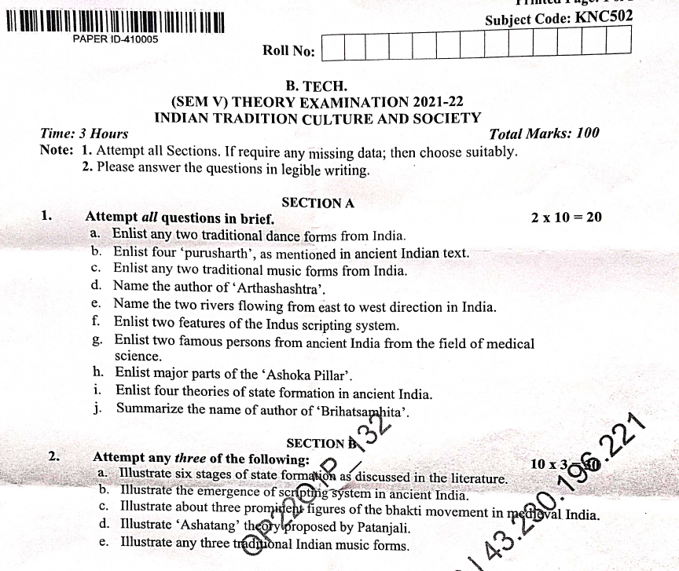
Old Question Papers

Slide 126
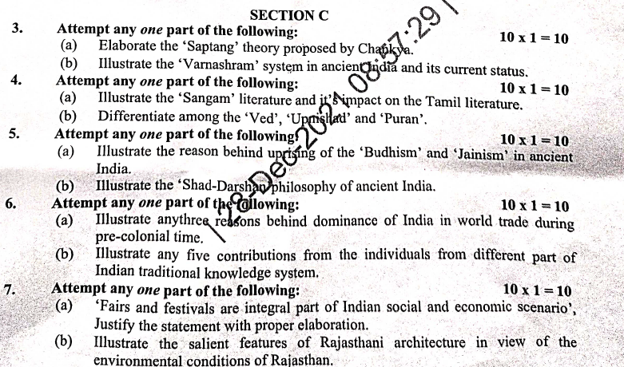
Old Question Papers

Slide 127
Expected Questions for University Exam
What are the popular assemblies mentioned in Atharvaveda during vedic age? Explain the function of them.
Why Tamil literature called Sangama literature?
What is Champu?
How did Urdu language came into use in India?
Briefly describe the development of Hindi language?
Identify the contributions of Indian languages and literature in shaping of Indian society?

Slide 128
Recap of unit
In this unit, we learned about Evolution of script and languages in India: Harappan Script and Brahmi Script.
We also studied, The Vedas, the Upanishads, the Ramayana and the Mahabharata, Puranas, Buddhist And Jain Literature in Pali, Prakrit And Sanskrit, Kautilya’s Arthashastra.
In this unit, we learned about Famous Sanskrit Authors, Telugu Literature, Kannada Literature, Malayalam Literature.
We also studied, Sangama Literature Northern Indian Languages & Literature, Persian And Urdu and Hindi Literature

Slide 129
References
V. Sivaramakrishna (Ed.), Cultural Heritage of India-Course Material, Bharatiya Vidya Bhavan, Mumbai, 5th Edition, 2014
S. Baliyan, Indian Art and Culture, Oxford University Press, India
Romila Thapar, Readings In Early Indian History Oxford University Press , India.
Basham, A.L., The Wonder that was India (34th impression), New Delhi, Rupa & co.
http://vedicheritage.gov.in/en/
Sharma, R.S., Aspects of Political Ideas and Institutions in Ancient India(fourth edition), Delhi, Motilal Banarsidass
Thank You

